Slide 1

Search Engine
By Alim Ul Karim
CSE 373 Introduction to Algorithms

Slide 2
Outlines
Introduction
Alim Ul Karim’s Algorithms
How did I do it?
How to make it better : Parallel Processing
Fast Recursion
How to make it more fast : Indexing
Hadoop !

Slide 3
Introduction to Search Engine Software

Slide 4
Examples

Slide 5
Info Rapid Example

Slide 6
Windows Search Example

Slide 7
Alim Ul Karim’s Algorithms

Slide 8
How did I do it?

Slide 9
Caching

Slide 10
How to make it better : Parallel Processing

Slide 11
Fast Recursion

Slide 12
Indexing

Slide 13
Hadoop!

Slide 14
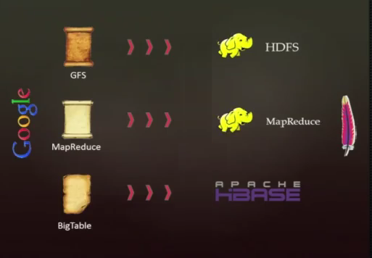

Slide 15
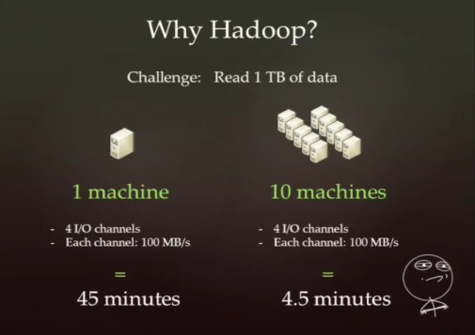

Slide 16
Questions ?

Slide 17
Thank You!
Alim Ul Karim
alim.karim.nsu@gmail.com

